Slide 1
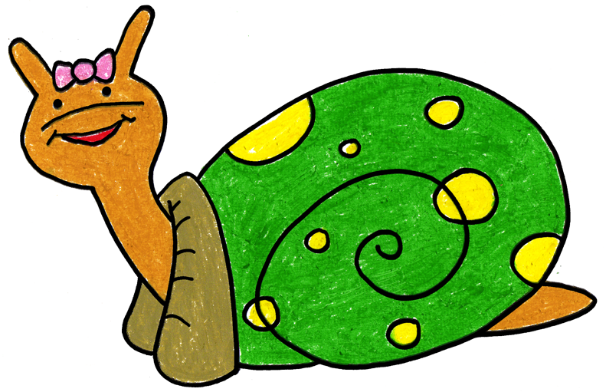
Sonia Snail Takes Time to Tuck and Think
Adapted 2012 by WestEd Teaching Pyramid from a scripted story to assist with teaching the “Turtle Technique”
Original By Rochelle Lentini March 2005
Artwork by Alejandro Castillon, 2011 WestEd

Slide 2
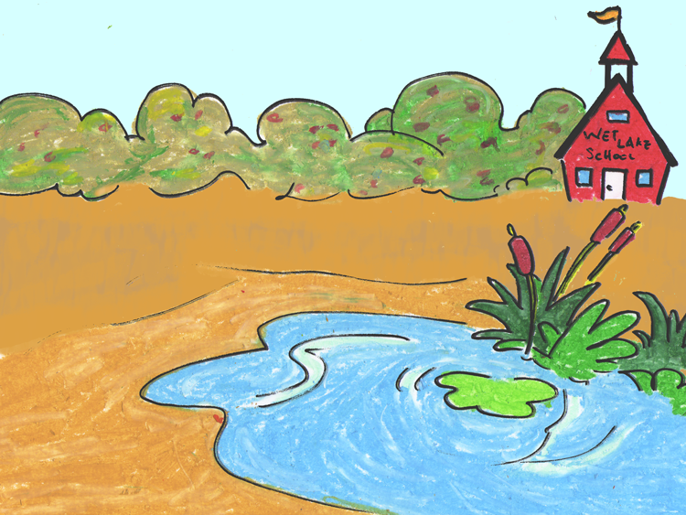
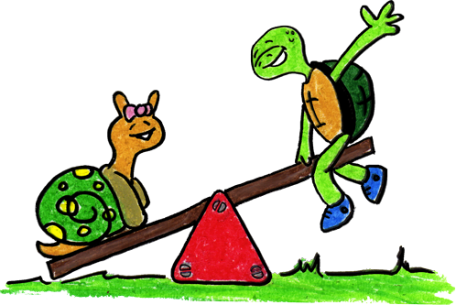
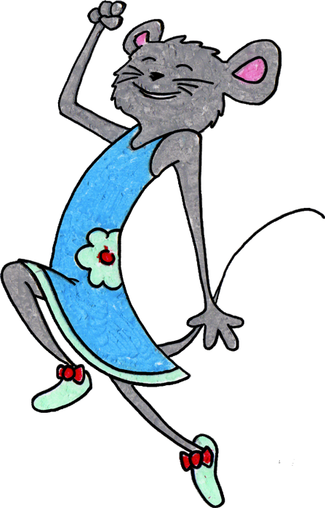
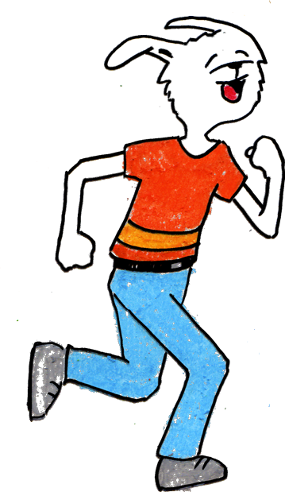
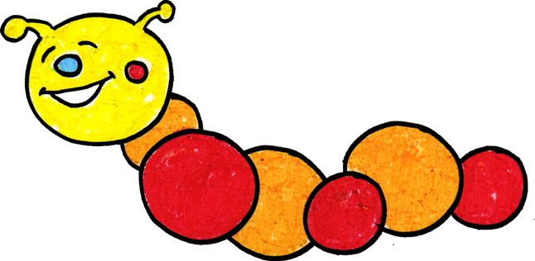
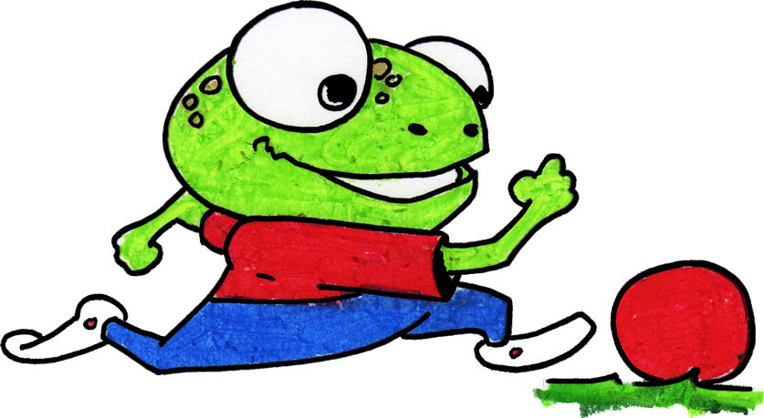
Sonia Snail is a terrific snail. She likes to play with her friends at Wet Lake School.

Slide 3
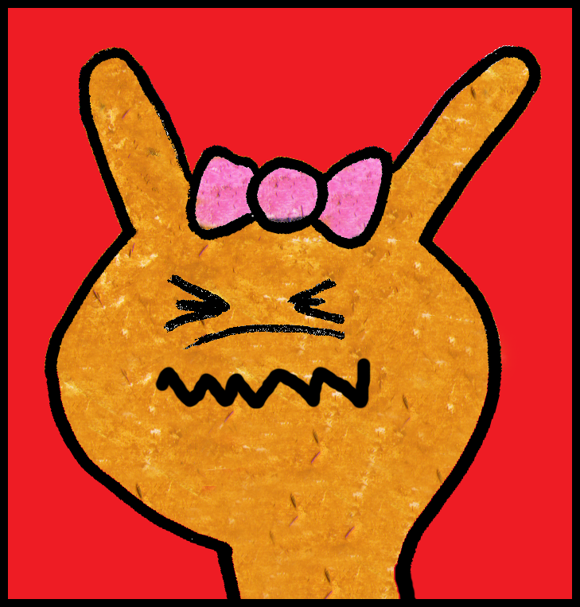
But sometimes things happen that can make Sonia really mad.

Slide 4
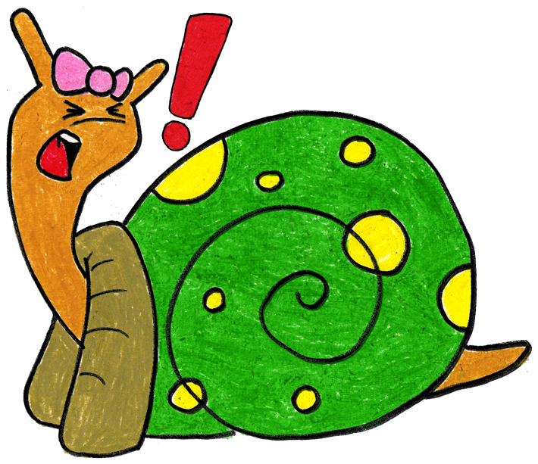
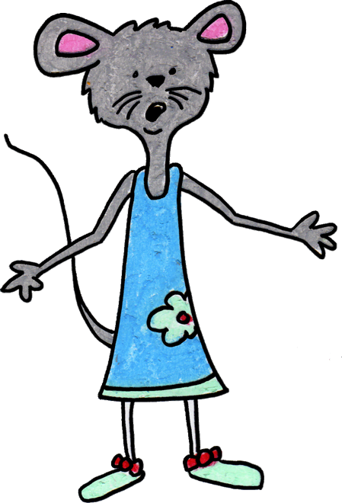
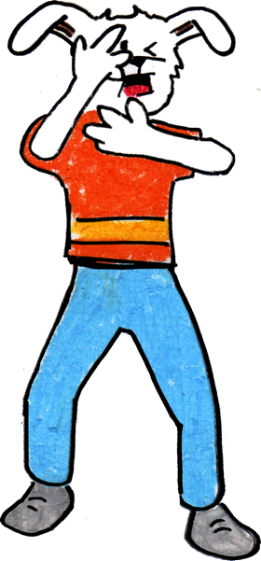
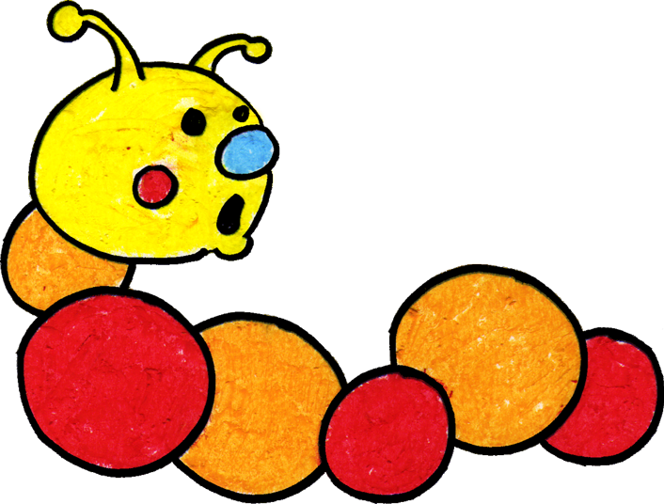
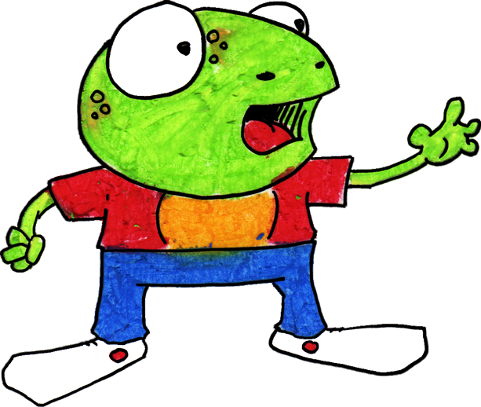
When Sonia got mad, she used to hit, kick, or yell at her friends. Her friends would get mad or upset when she hit, kicked, or yelled at them.

Slide 5
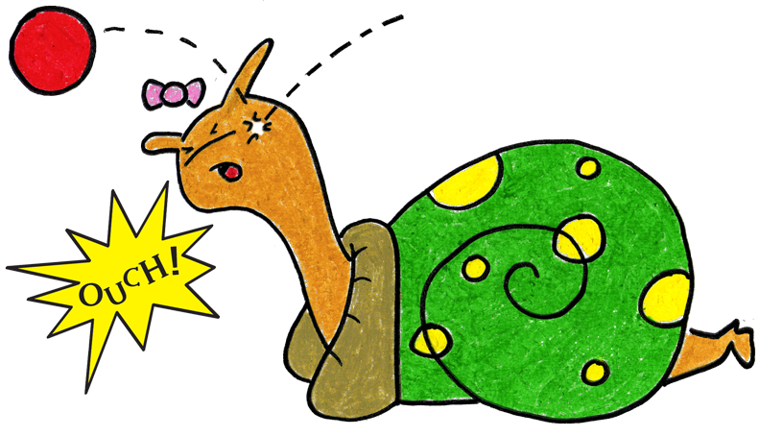
Sonia now knows a new way to “think like a snail” when something happens to make her mad.
Step 1

Slide 6
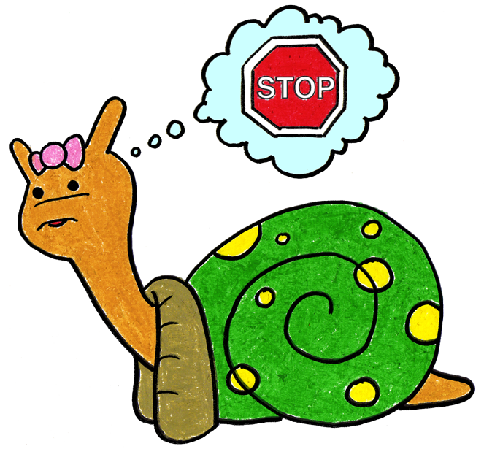
She can stop and keep her hands, body, and yelling to herself. She can think, “What am I feeling?” If she is angry, she can stomp her feet and say “I’m mad!”
Step 2

Slide 7
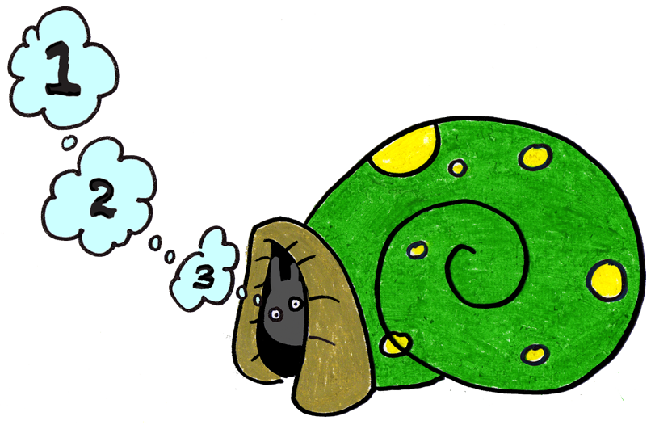
She can tuck inside her shell and take 3 belly breaths to calm down.
Step 3

Slide 8
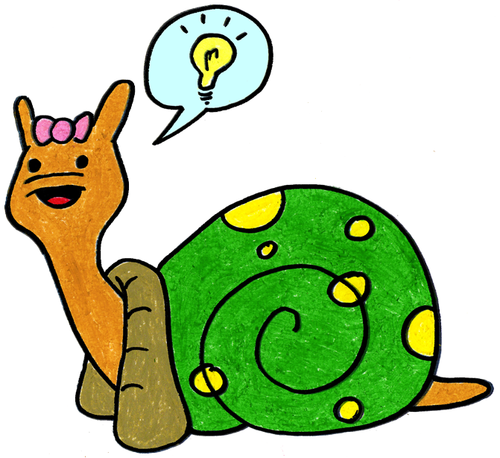
Sonia can come out of her shell, express her feelings, then think of a solution or a way to make it better.
Step 4

Slide 9
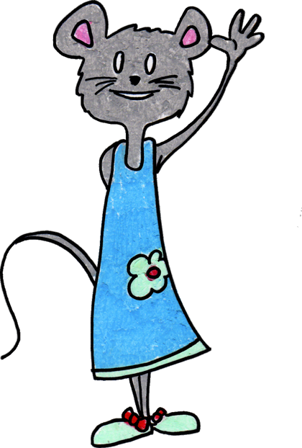
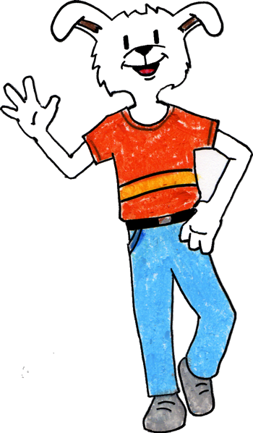
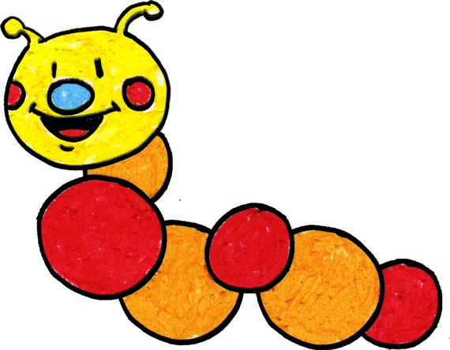
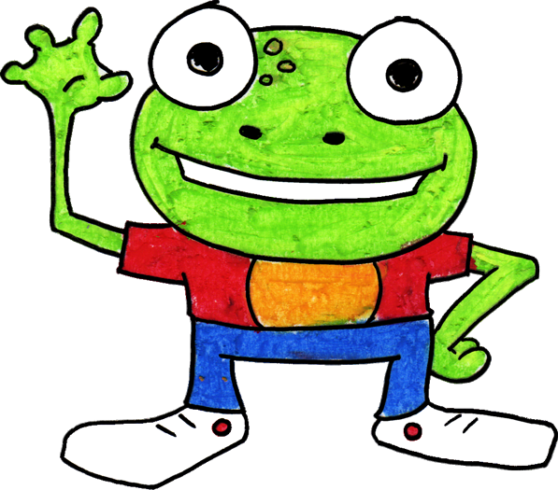
Sonia is happy when she plays with her friends and keeps her hands and body to herself. Friends also like it when Sonia stops and “thinks like a snail” when she gets mad.
If she forgets what to do, her teacher can help her when she is upset. Sonia has fun with her friends at Wet Lake School.

Slide 10
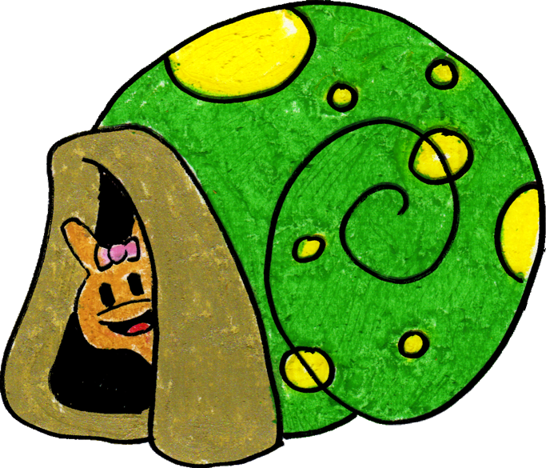
The End!
Adapted by WestEd Teaching Pyramid – www.CAinclusion.org/teachingpyramid

Slide 11
Something happens
Step 1
Adapted by WestEd Teaching Pyramid – www.CAinclusion.org/teachingpyramid

Slide 12
Stop. Think: What Am I Feeling?
Step 2
Adapted by WestEd Teaching Pyramid – www.CAinclusion.org/teachingpyramid

Slide 13
Go into your shell.
Take 3 belly breaths and think calm thoughts.
Step 3
Adapted by WestEd Teaching Pyramid – www.CAinclusion.org/teachingpyramid

Slide 14
Come out of shell, express your feelings and think of a solution.
Step 4
Adapted by WestEd Teaching Pyramid – www.CAinclusion.org/teachingpyramid

Slide 15
Tucking Technique (CA CSEFEL)
Something happens
Stop. Think: What Am I Feeling?
Go into your shell. Take 3 belly breaths and think calm thoughts
Come out of shell, express your feelings and think of a solution
Adapted by WestEd Teaching Pyramid – www.CAinclusion.org/teachingpyramid

Slide 16
Teacher Tips on the Tucking Technique
Model remaining calm
Teach the child the steps of how to manage feelings and calm down (“think like a snail”)
Step 1: Recognize that something happened.
Step 2: Stop. Think: what are you feeling? Acknowledge your feeling and maybe do something physical to let that feeling out.
Step 3: Tuck inside your “shell” and take 3 belly breaths to help you become calm.
Step 4: Come out, express your feelings, and think of a solution.
Practice steps frequently (see cue cards outlining each step)
Prepare for and help the child handle strong emotions and to think of a solution (see “What Can the Child Do?” list)
Give encouragement and acknowledgement as children make efforts to do the steps
Involve families – teach the “Snail Technique”
Adapted from Webster-Stratton, C. (1991). The teachers and children videotape series: Dina dinosaur school. Seattle, WA: The Incredible Years.

Slide 17
What Can The Child Do?
Help the Child Think of a Possible Solution: (These are from the Solution Kit)
Get a teacher
Ask in a friendly way
Ignore
Play
Say, “Please stop.”
Say, “Please.”
Share
Trade a toy/item
Wait and take turns
Set a Timer

Slide 18
Super Snail Letter
Dear Parent,
Billy was successful today with handling frustration and anger when we ran out of his favorite cracker at snack. When he felt himself getting upset, he stopped, took three belly breaths, and decided he would try one of the other crackers. That was a great solution and he really liked the new cracker, too! You can help Billy at home by asking him what he did at school today when we ran out of his favorite cracker. Ask him how he calmed down. Comment on what a good problem solver he is. Tell him that you hope that he will do that again when he gets frustrated about something. Thank you so much! Ms. Laura

